Slide 1
Bracketing Methods

Slide 2
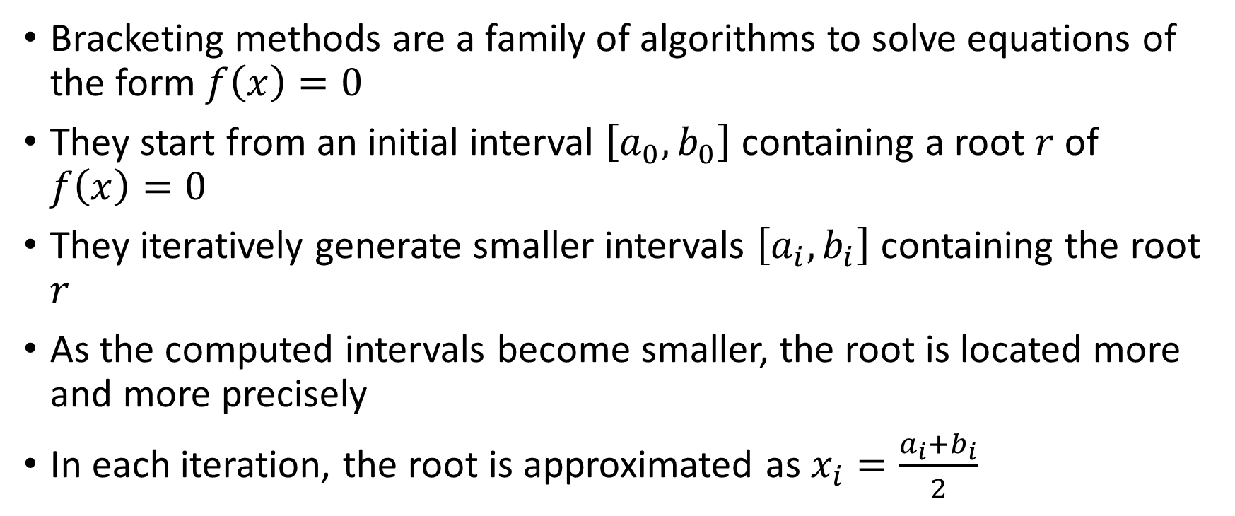
Bracketing methods are a family of algorithms to solve equations of the form $f\left(x\right)=0$
They start from an initial interval $\left[a_{0},b_{0}\right]$ containing a root $r$of $f\left(x\right)=0$
They iteratively generate smaller intervals $\left[a_{i},b_{i}\right]$ containing the root $r$
As the computed intervals become smaller, the root is located more and more precisely
In each iteration, the root is approximated as $x_{i}=\frac{a_{i}+b_{i}}{2}$
Notes:
Bracketing methods are a family of algorithms to solve none linear equations in one variable.
These methods aim to provide a series of intervals which will, as the algorithm is proceeding, located more and more precisely the solution of the equation.
To do this one has first to feed the algorithm with an initial interval [ao, bo]. This interval must contain the solution r of the equation we try to solve.
We will discuss soon how we can know that indeed the solution r is within this interval. For the moment just assume we know it.
The algorithm will use this interval to compute a new interval [a1, b1] which, on one side still contains the root, and the other side is smaller than the initial interval [ao, bo].
The algorithm will proceed iteratively and provide a series of intervals [ai, bi], all containing the solution r, but becoming smaller and smaller as the calculations proceed.
As the algorithm proceeds, the solution r is located more and more precisely.
In each iteration, the searched solution r can be approximated by the mid-point of the interval, which is (ai+bi)/2.

Slide 3

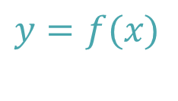







$$y$$
$$y=f(x)$$
$$a_{2}$$
$$r$$
[
[
[
]
]
]
$$a_{o}$$
$$a_{1}$$
$$b_{2}$$
$$x$$
$$b_{1}$$
$$b_{o}$$
Notes:
Let us explain these calculations with a figure.
First we plot our function y=f(x).
In our example f(x) has one root r.
Then we start the algorithm with an initial interval [ao, bo] bracketing the root r of the function f(x).
The algorithm computes then a smaller interval [a1, a2] around the searched root r.
Iterations can proceed further to determine an even smaller interval [a2, b2].
Note how the root is located more and more precisely as the intervals become smaller and smaller.

Slide 4
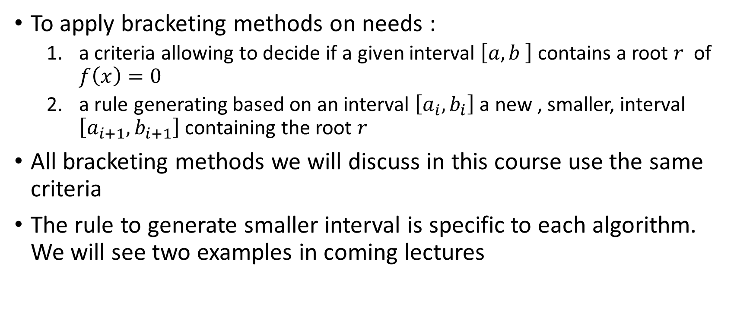
Essential steps
To apply bracketing methods on needs :
a criteria allowing to decide if a given interval $\left[a,b \right]$ contains a root $r$ of $f\left(x\right)=0$
a rule generating based on an interval $\left[a_{i},b_{i}\right]$ a new , smaller, interval $\left[a_{i+1},b_{i+1}\right]$ containing the root $r$
All bracketing methods we will discuss in this course use the same criteria
The rule to generate smaller interval is specific to each algorithm. We will see two examples in coming lectures
Notes:
Now that we have an intuitive understanding on how bracketing methods work, let us identify the essential steps.
In fact we need two essential skills.
First we need a criteria that allows us to decide if a given interval [a, b] contains a root of the function f(x) or not.
Second we need a rule which will generate from a given interval [ai, bi] a new interval [ai+1, bi+1], smaller than the pervious one, still containing the root.
All bracketing methods we will discuss in this course use the same criteria.
As for the rules to generate smaller interval we will see two examples. These rules are specific to a given algorithm.

Slide 5
How to guarantee a root is within a given interval ?
Notes:
Let us now focus on the criteria that allows us to decide if a given interval [a, b] contains a root of the function f(x) or not.
Or asked differently:
How to guarantee a root is within a given interval ?

Slide 6

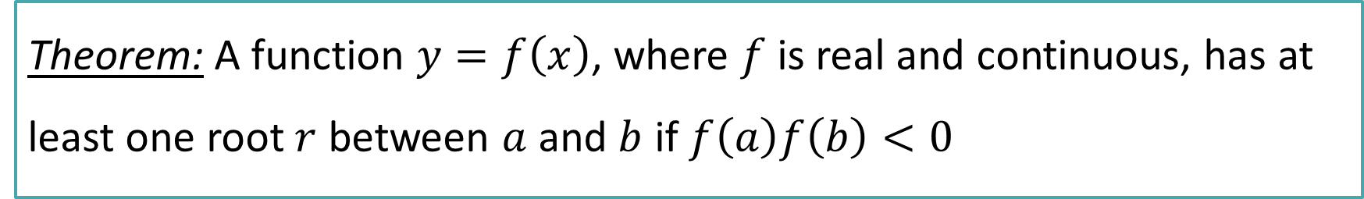





Theorem: A function $y=f\left(x\right)$, where $f$ is real and continuous, has at least one root $r$ between $a$ and $b$ if $f\left(a\right)f\left(b\right)<0$
$$y$$
$$y=f(x)$$
$$f(b)$$
$$a$$
$$r$$
$$b$$
$$x$$
$$f(a)$$
Notes:
To guarantee a root is within a given interval we will use the following theorem :
A function $y=f\left(x\right)$, where $f$ is real and continuous, has at least one root $r$between $a$ and b if $f\left(a\right)f\left(b\right)<0$.
From the figure it is quite obvious that if f(a)f(b)<0, which means that the function is actually changing it’s sign over the interval [a, b], there must be a root.
If the function changes its sign, it must cross the x-axis.
This theorem can be used as a criteria to verify that there is a root within the interval [a, b].

Slide 7











If $f\left(a\right)f\left(b\right)<0 \text{there} \text{is} \text{at} \text{least} \text{one} \text{root} \text{in} \text{the} \text{interval}$
$$y$$
$$y=f(x)$$
$$f(a)$$
$$r_{1}$$
$$r_{2}$$
$$b$$
$$a$$
$$x$$
$$r_{3}$$
$$f(b)$$
Three roots
Notes:
The theorem says that if$f\left(a\right)f\left(b\right)<0$ there is a root in the interval [a, b].
But there could be more than one root.
Consider the example on the slide. We have $f\left(a\right)f\left(b\right)<0.$
For this interval [a,b] we have not just one root, but in fact we have three roots.
The take away is that if $f\left(a\right)f\left(b\right)<0$, we are sure that there is a root in the interval.
But there could be more than one root.

Slide 8






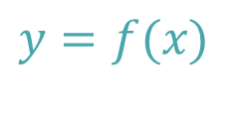

If $f\left(a\right)f\left(b\right)>0$ there may or may not be a root
$$y$$
$$y=f(x)$$
$$f(b)$$
$$f(a)$$
$$a$$
$$b$$
$$x$$
no root
Notes:
It is important to note that the theorem guarantees that there is at least one root if $f\left(a\right)f\left(b\right)<0$ .
However, it doesn’t say anything about the case where f(a)f(b)>0
When $f\left(a\right)f\left(b\right)>0$ there may or may not be a root.
Consider a and b as shown on the figure.
Here we have $f\left(a\right)f\left(b\right)>0$.
As we can see there are no roots in the bracket [a, b] we selected.

Slide 9







If $f\left(a\right)f\left(b\right)>0$ there may or may not be a root
$$y$$
$$y=f(x)$$
$$f(b)$$
$$f(a)$$
$$a$$
$$b$$
$$x$$
$$r_{1}$$
$$r_{2}$$
two roots
Notes:
But we could have selected a different interval.
Consider a and b as on the figure.
We still have $f\left(a\right)f\left(b\right)>0$.
As we can see, this time there are two roots in the bracket we selected.
The take-away of this example is that if $f\left(a\right)f\left(b\right)>0$, there could still be roots. But we can’t know for sure that there is a root.
On the contrary if $f(a)f\left(b\right)<0$ then we know for sure that there is a root within the interval.
However there could be more than one root.

Slide 10
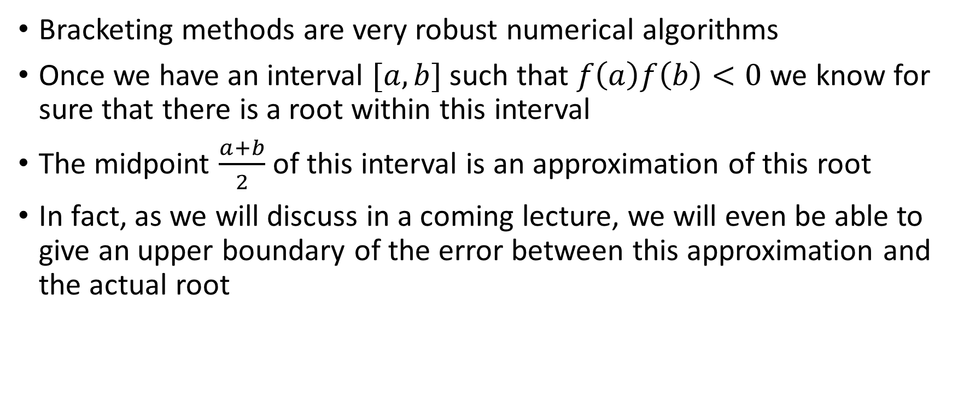
Bracketing methods are very robust numerical algorithms
Once we have an interval $[a,b]$ such that $f\left(a\right)f\left(b\right)<0$ we know for sure that there is a root within this interval
The midpoint $\frac{a+b}{2}$ of this interval is an approximation of this root
In fact, as we will discuss in a coming lecture, we will even be able to give an upper boundary of the error between this approximation and the actual root
Notes:
Let us summarize our findings.
First of all, and this is among the greatest advantages of bracketing methods, these methods are very robust.
Indeed, once we have f(a)f(b)<0, we know for sure that there is at least one root within the interval [a, b].
The midpoint (a+b)/2 of this interval is an approximation of this root.
We will learn in a coming lecture, that we will even be able to give an upper boundary of the error between this approximation and the actual root.

Slide 11
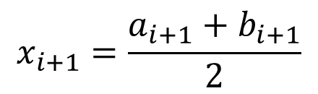
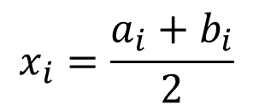
[a_{i}, b_{i}]
[a_{i+1}, b_{i+1}]
$$x_{i}=\frac{a_{i}+b_{i}}{2}$$
$$x_{i+1}=\frac{a_{i+1}+b_{i+1}}{2}$$
Bracketing Method
Notes:
Considering our bracketing method as a black-box we can summarize it as follows.
Starting from an interval [ai, bi] containing the root r we want to locate, the algorithm will generate a new interval [ai+1, bi+1] locating the root.
The approximation of the root is the midpoint of this interval.

Slide 12
Cases where bracketing methods fail
Notes:
As discussed, bracketing methods are very robust methods. However, if not applied correctly they can still fail.

Slide 13

Bracketing methods unable to locate a root
If the function $f\left(x\right)$, from which one wants to find the root, is purely positive (or negative) around the root $r$, bracketing methods can not be used
The reason is that, even $r$ is a root, one can not give an interval $\left[a,b\right]$ containing the root such that $f\left(a\right)f\left(b\right)<0$
Notes:
There are cases where bracketing methods can not locate roots.
This happens when we have a purely positive (or negative) function in the vicinity of the root.
In this situation we cannot find any interval [a,b] such that f(a)f(b) < 0

Slide 14
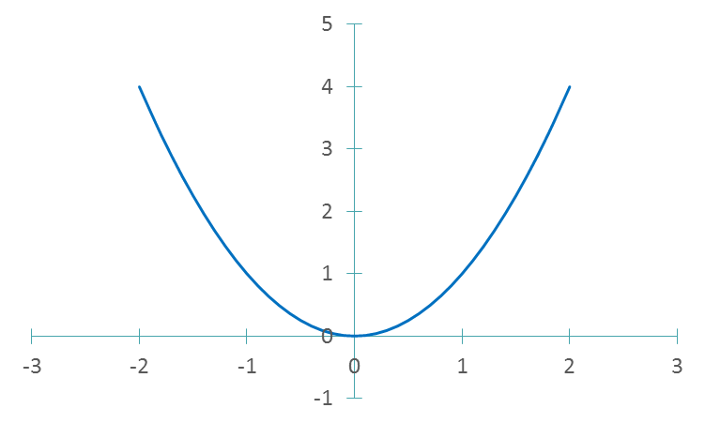


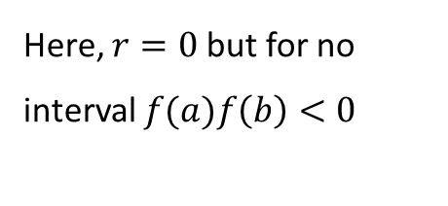
$$y=x^{2}$$
Here, $r=0$ but for no interval $f(a)f\left(b\right)<0$
$$r$$
Notes:
A simple example of this situation is the function y=x^2
y=x^2 has a root in x=0. But you cannot find any interval such that f(a)f(b) < 0

Slide 15

Bracketing methods locate something which is not a root
Bracketing methods will fail when$f\left(x_{ }\right)$ has a singularity.
Indeed for such functions one can have $f(a)f\left(b\right)<0$ even if no root is within the interval $\left[a,b\right]$
Notes:
A second situation where bracketing methods fails is when you try to apply it to none continuous functions.
If the function f(x) has a singularity you may find intervals [a,b] such that f(a)f(b) < 0 even that there is no root within this interval.

Slide 16
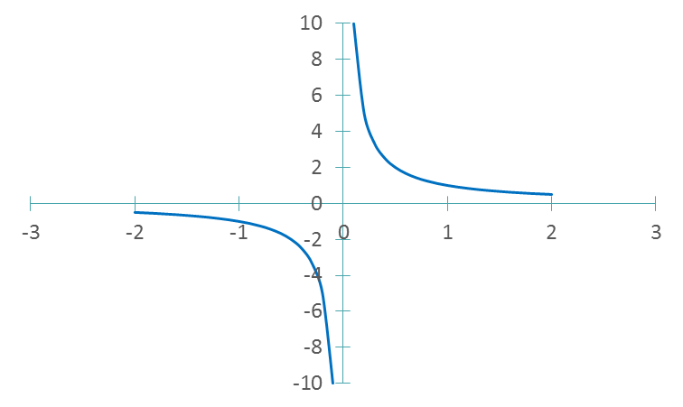
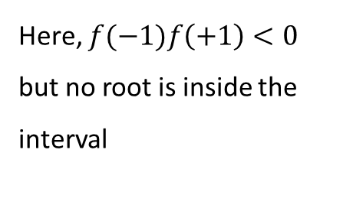

Here, $f(−1)f\left(+1\right)<0$ but no root is inside the interval
$$y=\frac{1}{x}$$
Notes:
A typical example is the function y=1/x
Here the interval [-1,1] with result in f(-1)f(1) < 0
But there is no root in the interval [-1, 1].

Slide 17
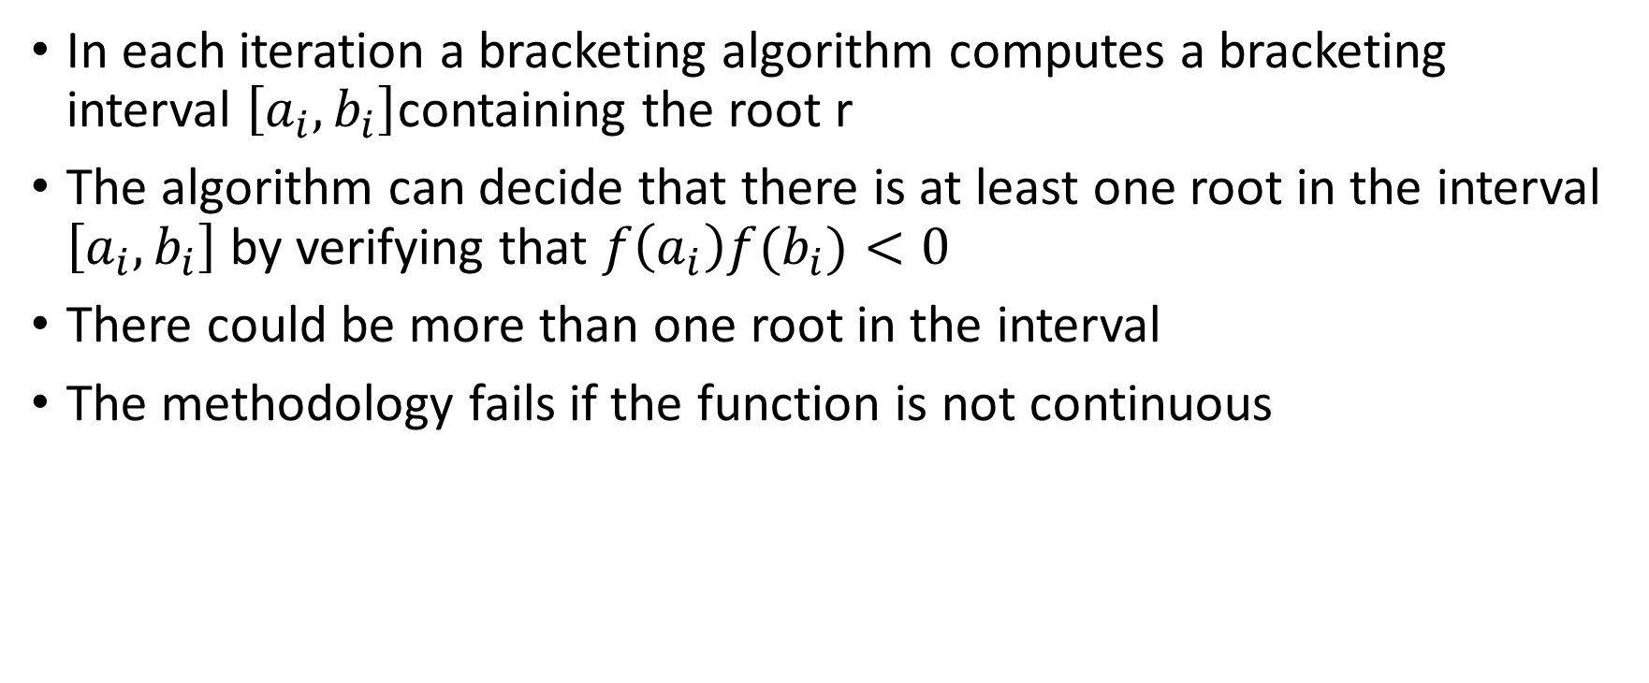
Summary
In each iteration a bracketing algorithm computes a bracketing interval $\left[a_{i},b_{i}\right]$containing the root r
The algorithm can decide that there is at least one root in the interval $\left[a_{i},b_{i}\right]$ by verifying that $f\left(a_{i}\right)f(b_{i})<0$
There could be more than one root in the interval
The methodology fails if the function is not continuous
Notes:
Let us summarize the key findings
In each iteration a bracketing algorithm computes a bracketing interval $\left[a_{i},b_{i}\right]$containing the root r
The algorithm can decide that there is at least one root in the interval $\left[a_{i},b_{i}\right]$ by verifying that $f\left(a_{i}\right)f(b_{i})<0$
There could be more than one root in the interval
The methodology fails if the function is not continuous
In coming lectures we are going to see two examples of bracketing methods: the bisection algorithm and the secant algorithm.

